Slide 1
Flight Delays in the U.S.
Leveraging Delayed Arrivals for Monetary Compensation

Slide 2
Contents
1. Context
2. Data Overview
3. Deep-Dive Analysis
4. Conclusion
5. Discussion and Critique

Slide 3
Context
Travel Opportunities for U.S. GIFT Participants

Slide 4
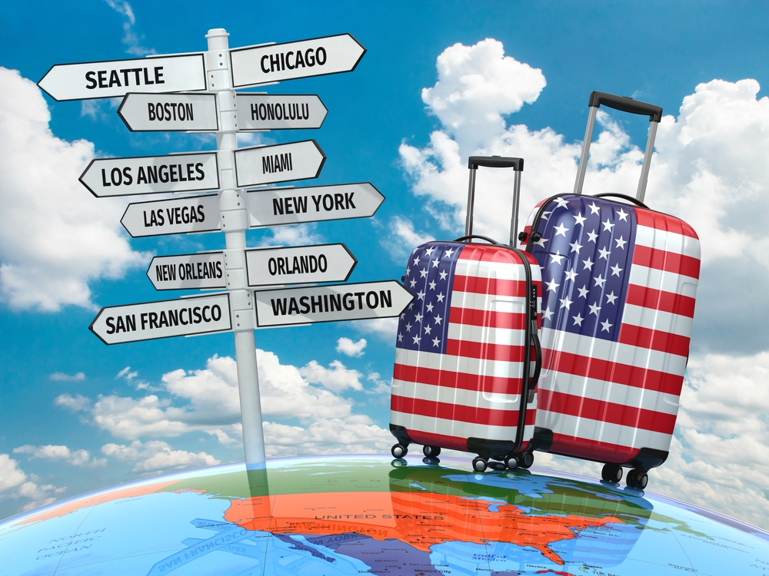
Travel Hack for U.S. GIFTs
Flight Delays Provide Monetary Compensation that Enable Free Flights
Situation: Student looking for cheap travel options
Analysis: Explore NYC airports for patterns in arrival delays
Goal: Provide recommendation on cheap travel opportunities (high probability of monetary compensation)
Source: tamarathiessen.com

Slide 5
Data Overview
Brief Insights and Method

Slide 6
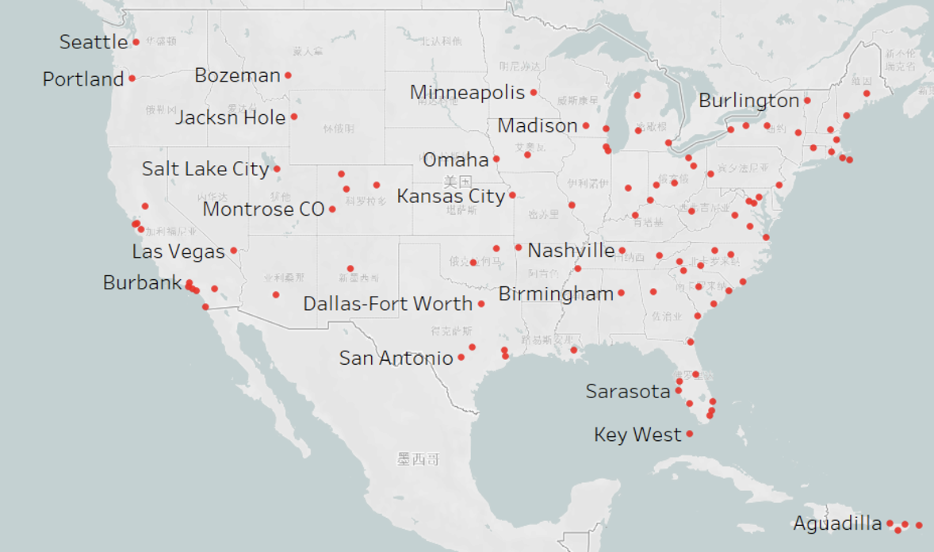
Kaggle Dataset: New York City Airport Activity
Collection of flight meta data on NYC airports
Overview:
~33,000 flights
3 Airports: JFK, LaGuardia, Newark
16 Carriers
>100 destinations across the US
Refund for arrival delay >180 min

Slide 7
Top-Down Approach
Cleaning, Investigating, Analysing, Concluding
Cleaning: Generating consistent data while creating relevant parameters
Statistical Significance: Conducting EDA to identify statistically significant differences across parameters
Analysis: Selection of parameters to create highest probability for late arrival compensation

Slide 8
Deep-Dive Analysis
NYC Airport Departures

Slide 9
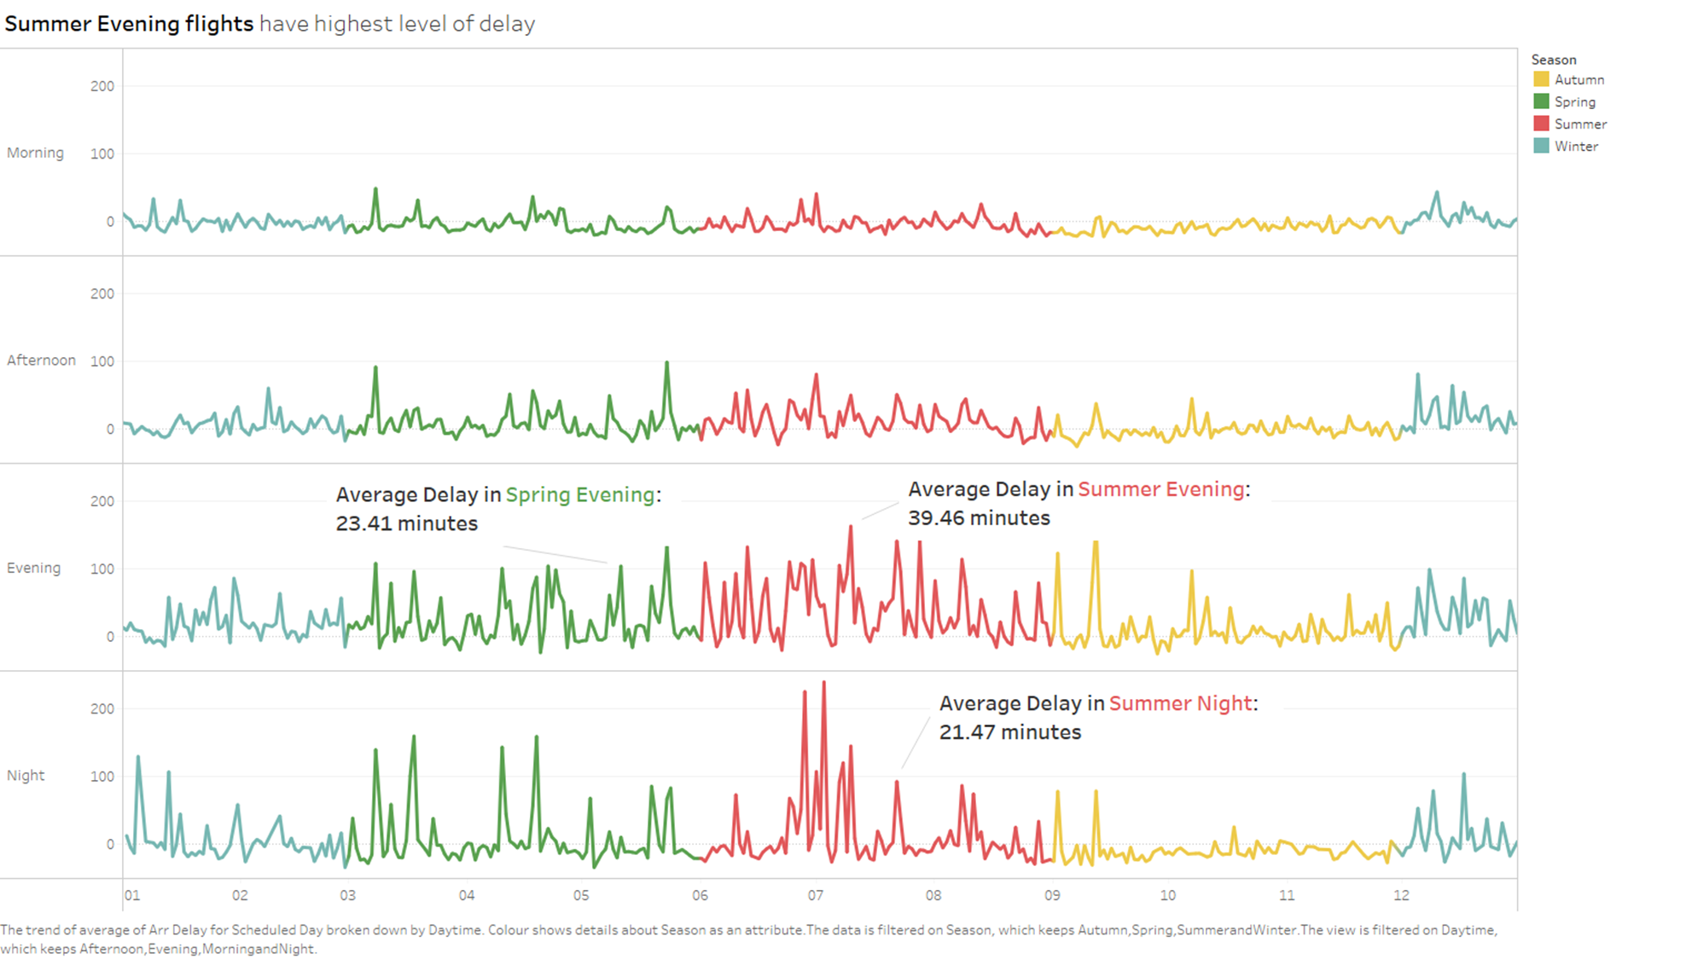
Season and Daytime
Delay Amasses Throughout the Day and Peaks at Evening Times
Summer period is the most sensitive to arrival delays
Evening and night have the highest average delay in summer

Slide 10
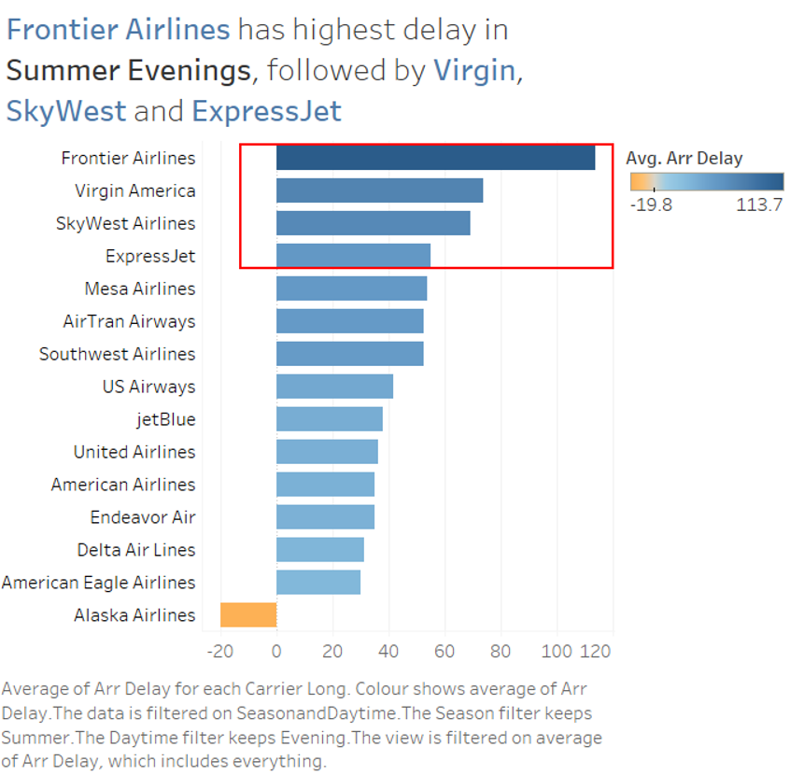
Airlines
Arrival Delays Seem Rather Normal to Airlines
Majority of Airlines cause delay
Top 25%:
Frontier Airlines
Virgin America
SkyWest Airlines
ExpressJet

Slide 11
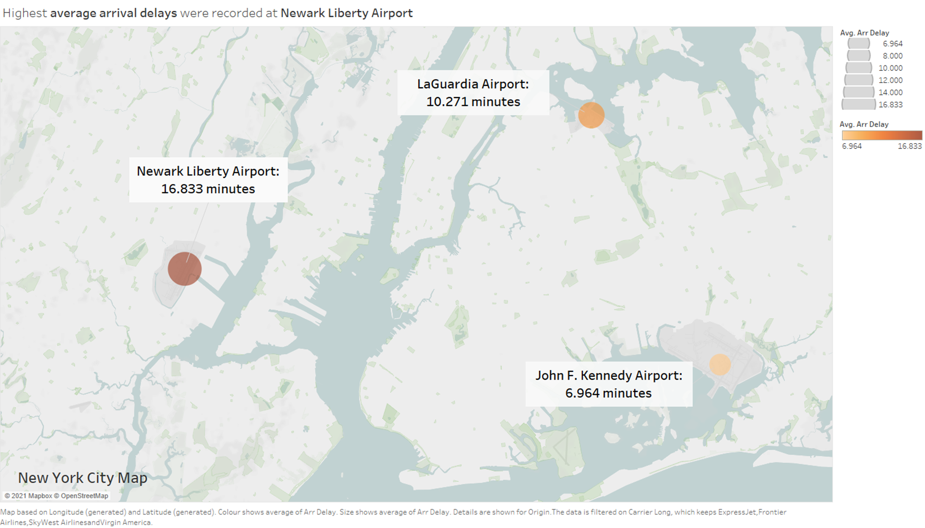
NYC Airports
Newark (EWR) Generates the Most Delay on Air Travel in NYC
All of the three (3) Airports show an average arrival delay for the destinations they serve
Newark Liberty Airport (EWR) with highest average arrival delay among airports

Slide 12
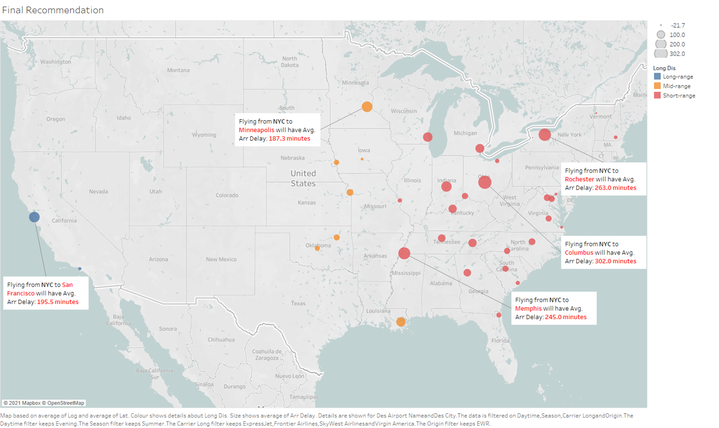
Destinations
Destinations with Highest Delay per Range
It is possible to differentiate between short, medium and long range
Columbus, Minneapolis and San Francisco produce highest average delays in their range category

Slide 13
Conclusion
Final Travel Recommendations for Students

Slide 14


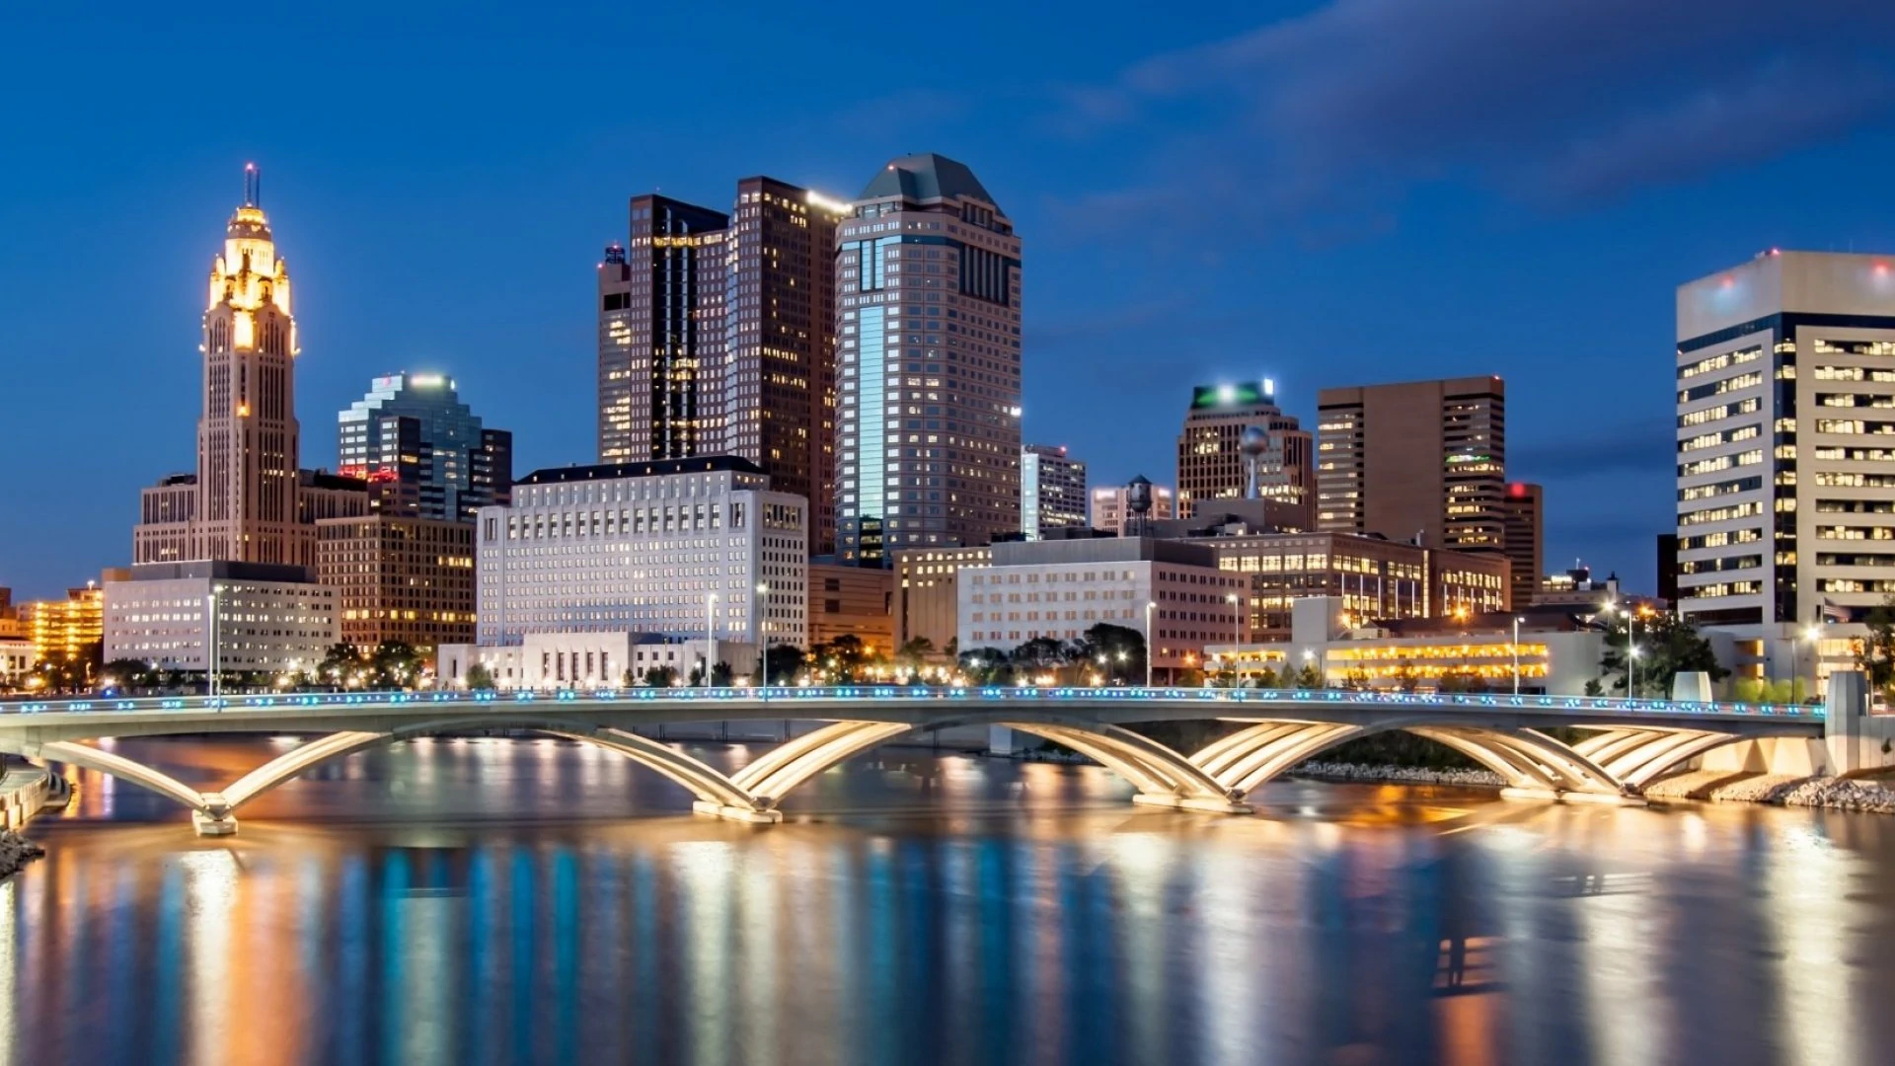
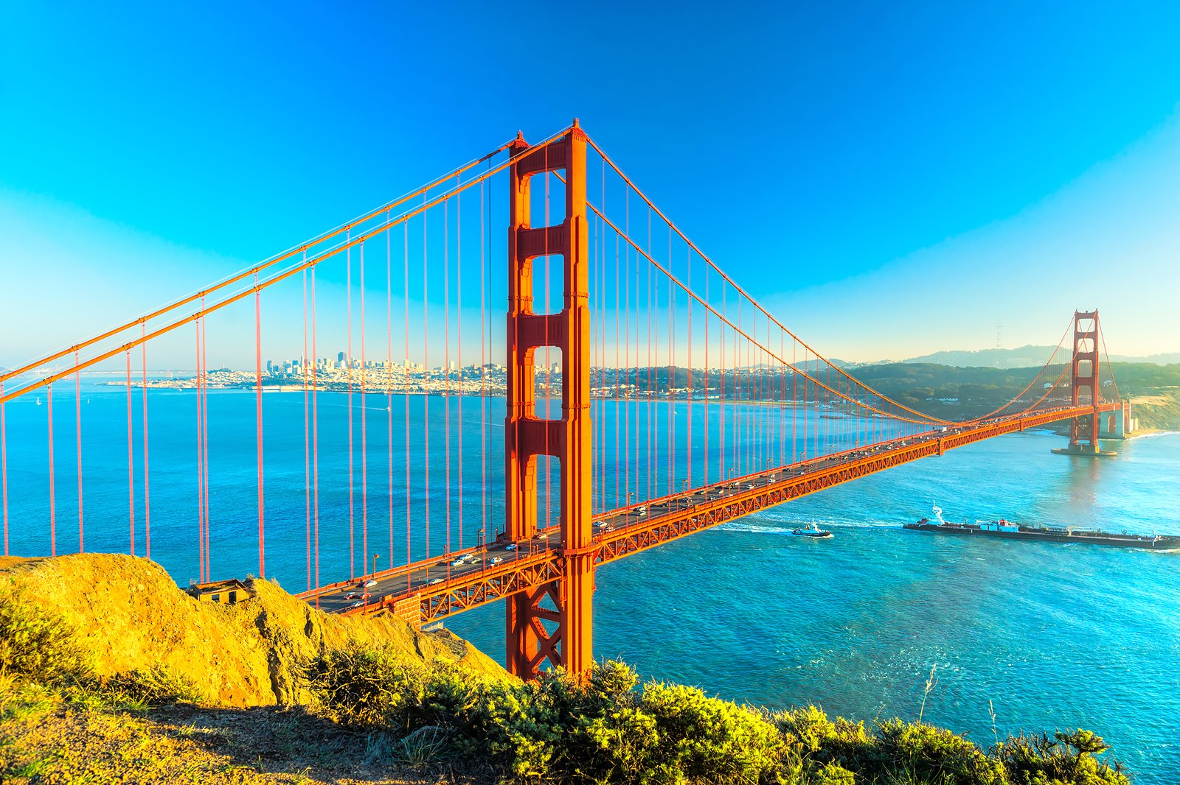
Conclusion
Summer – Evening - Newark Airport
Short-range: Columbus, OH
ExpressJet
Medium-range: Minneapolis, MN
ExpressJet
Long-range: San Francisco, CA
Virgin America

Slide 15
Discussion and Critique
Final Reflection on the Analysis Conducted

Slide 16
Discussion & Critique
Analysis:
Insightful
Data preparation (e.g., Missing columns)
Potential Future Opportunities:
Destinations outside of US
Fix issues with External Validity (e.g., longer timeframe)

Slide 17
Thank You for Listening!
For more information, please visit:
https://github.com/tayadav/Data_visualization

Slide 18
Appendix

Slide 19
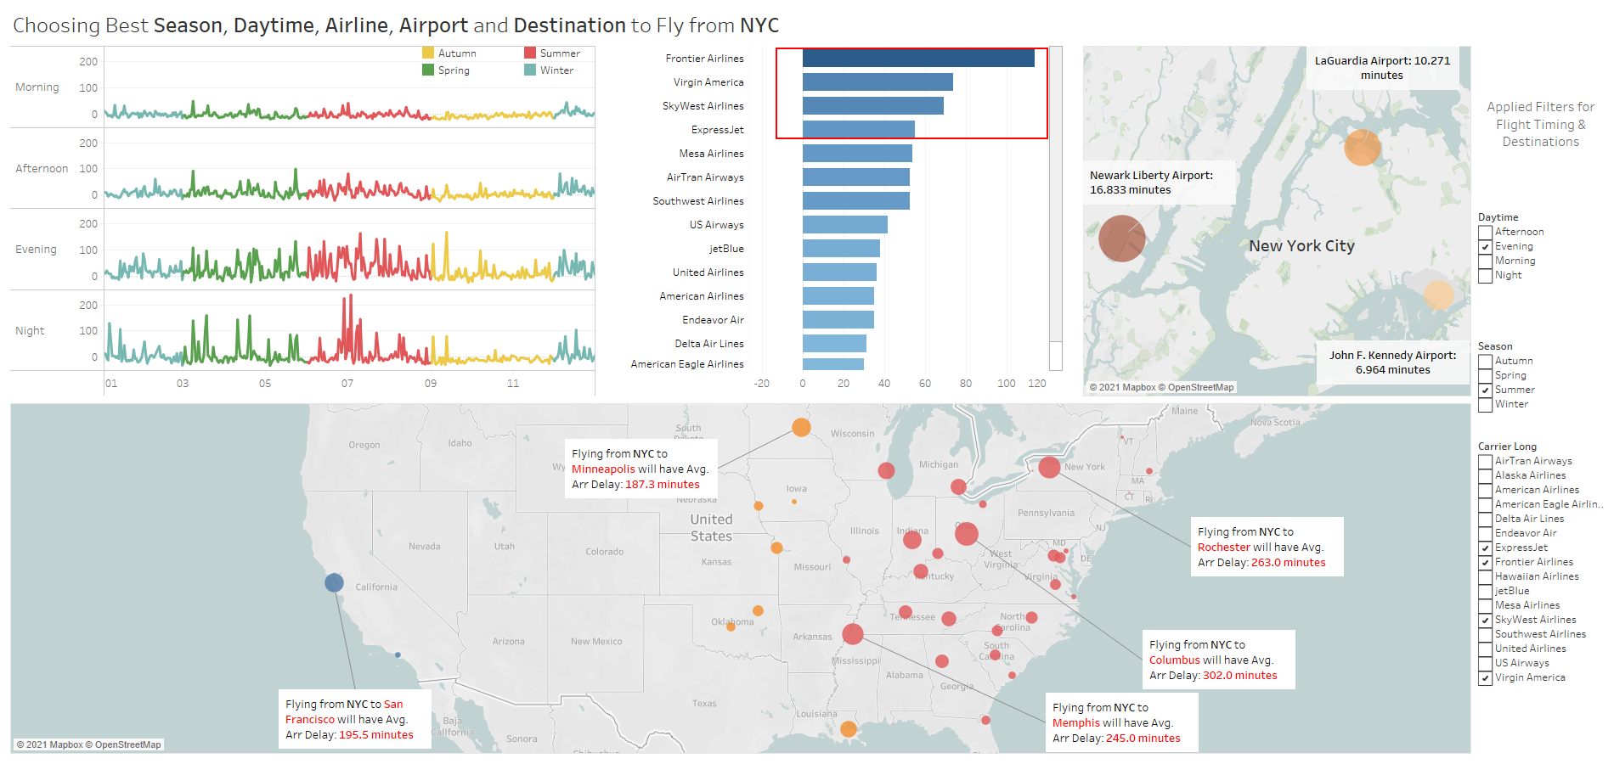

Slide 20
